Slide 1
Microservices
Programming Palli

Slide 2
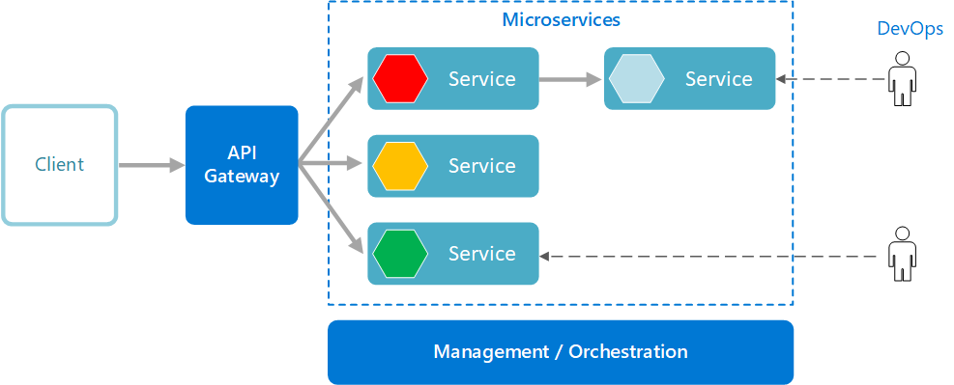
Microservices Architecture
A microservices architecture consists of a collection of small business services that can work together and can be deployed autonomously and indenpendently.

Slide 3
Microservice Characteristics
Microservices are small, independent, and loosely coupled.
Each service is a separate codebase.
Each service is a separate database.
Services can be deployed independently.
Services communicate with each other by using well-defined APIs. Internal implementation details of each service are hidden from other services.
Supports polyglot programming.

Slide 4
Thank You
Please subscribe

